Slide 1
NetApp. Наша специализация - технологии управления данными
Роман Ройфман
Технический директор NetApp Россия

Slide 2



























NetApp at a glance
Global cloud-led, data-centric software company
Founded in 1992, headquartered in Sunnyvale, California
Fortune 500 company (NASDAQ: NTAP)
$5.41B FY20 revenue
38,000+ customers around the world
Industry-leading cloud and enterprise data center solutions and services
10,800+ employees + 5,400 partners helping customers thrive in a hybrid multicloud world
98 offices in over 30 countries
Industry-leading cloud data services
Cloud
storage
Compute operations
Cloud
controls
Cloud services and analytics
Industry-leading storage systems and software
Flash and hybrid storage
Object storage
Converged and hybrid cloud infrastructure
Protection
and security
Enterprise solutions
Industry-leading solutions with an open ecosystem of partners

Slide 3
We are a global cloud-led,
data-centric software company
that helps organizations
lead with data and accelerate
their digital transformation

Slide 4

















Market leaders across diverse industries rely on NetApp
X of the top 10 companies in their industries use NetApp
10
9
9
5
8
9
Aerospace
and defense
Automotive
Business
services
Construction
Consumer
product
Financial
services
10
10
8
10
10
10
Healthcare
Hi-tech
Insurance
Life science
Manufacturers
Media
9
10
10
10
10
Oil and gas
Retailers
Software and IT
Telcos
Transportation
Source: NetApp Corporate Strategy; includes customers of both on-premises solutions and public cloud services
Notes:
Leaders rely on NetApp
A large installed base…… of very satisfied customers
All the leading companies across all the top verticals…. The key takeaway is Industry leaders rely on NetApp
They look to NetApp to solve their expanding workload challenges.​
They look for our leadership across flash, object, private clouds and hybrid cloud, and public cloud to meet their increasing needs.​

Slide 5



NetApp:
(a V b ), где a=«on-prem», b=«облако»
on-premises
публичные облака

Slide 6








Тренды в управлении
Изменение в ролях управления и потребления ресурсами хранения
Администраторы СХД ☛ админы инфраструктуры /ИТ универсалы
DevOps – потребители, которым нужен автоматизированное самообслуживание
Администрирование без разделения на on-premises и облака
Самоуправление СХД / масштабируемость
Управление на основе политик. Гибкость и контроль ресурсов.
Аналитика, DL / ML для самоуправления
Простое управление масштабируемыми ресурсами on-premises как в облаке
Открытые Framework управления ресурсами
Infrastructure as code (Ansible & Terraform)
RESTful API повсеместно
© 2019 NetApp, Inc. All rights reserved. --- NETAPP CONFIDENTIAL ---

Slide 7
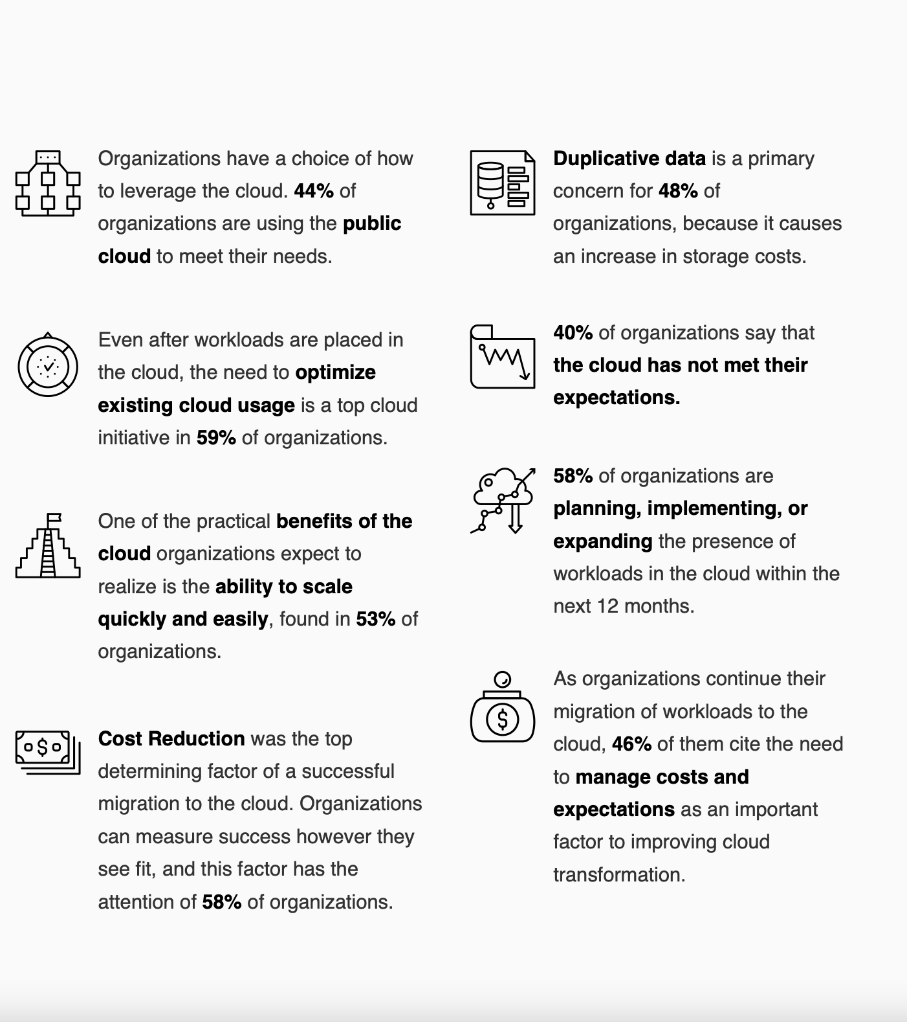
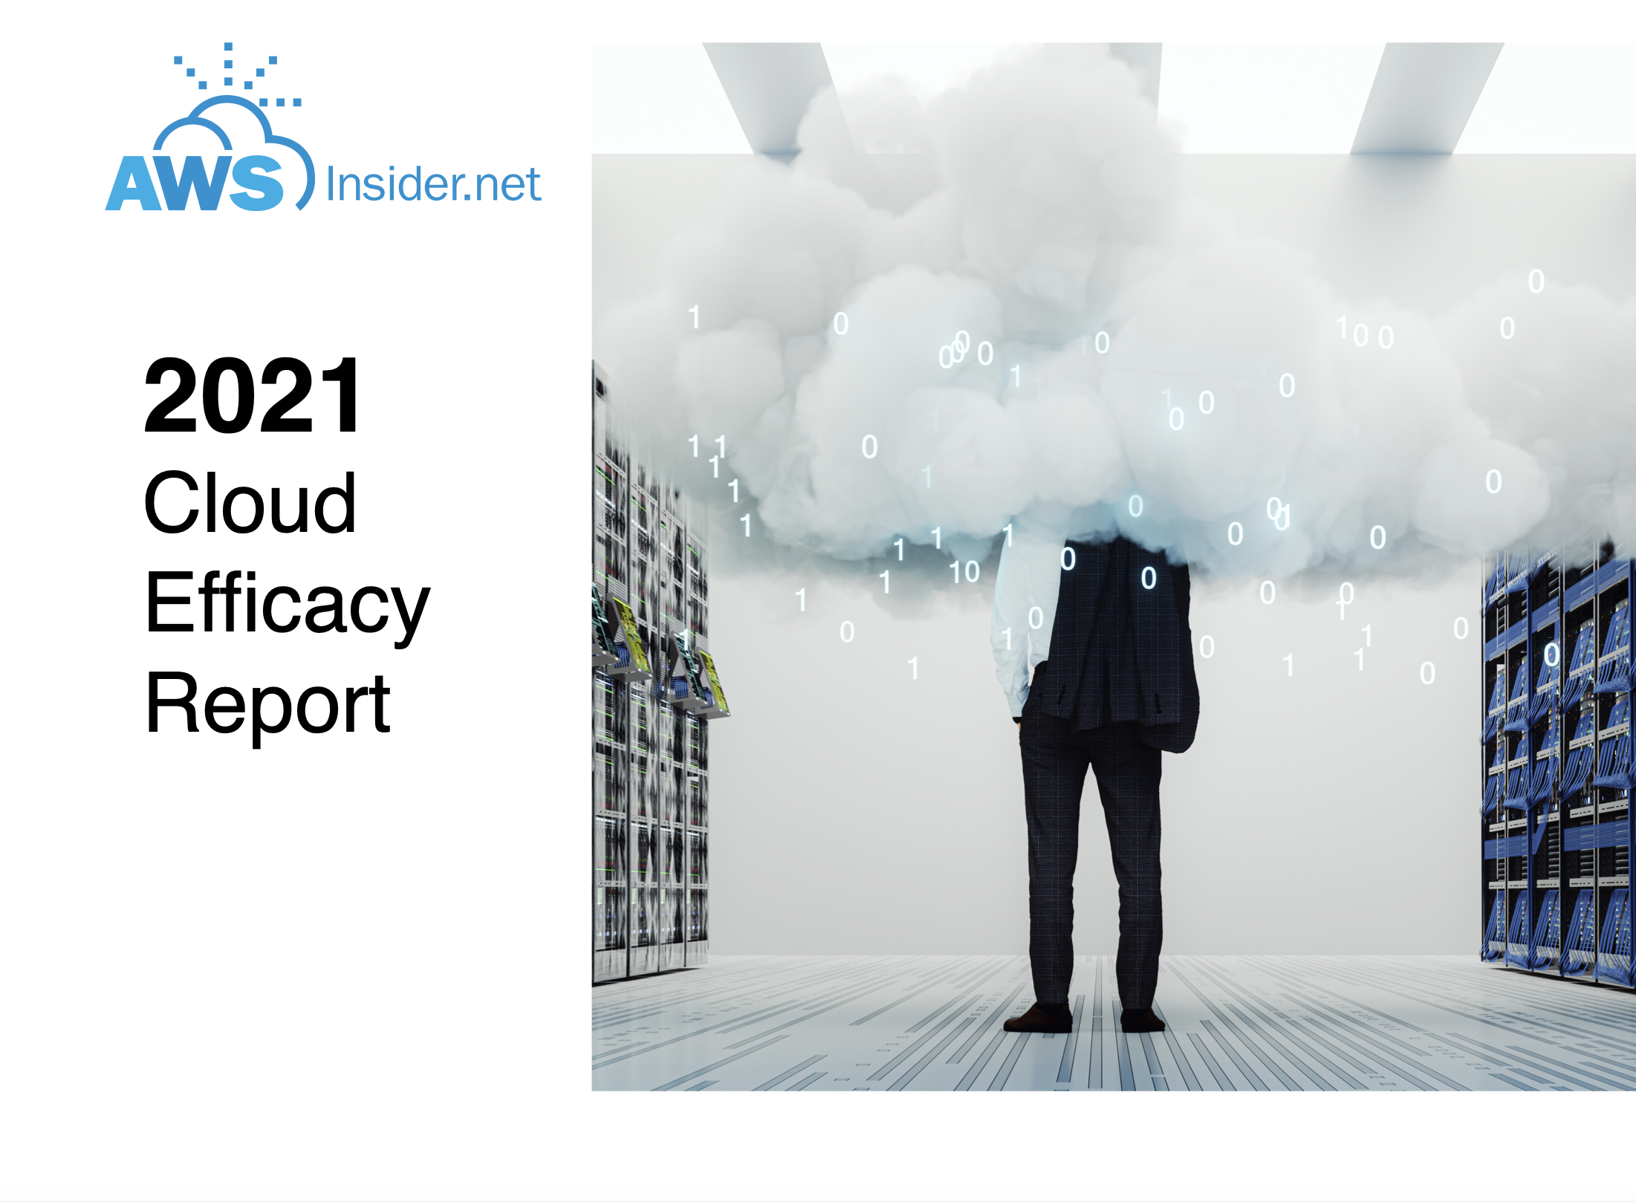
Making NVMe Ubiquitous
Industry leadership as first end-to-end
enterprise NVMe offering
Notes:
Nondisruptive upgrade to a modern SAN
Deliver 60% more performance
Reduce latency by 50%
Simple ONTAP upgrade to existing systems
2020: Completing rollout
A250 launch completes end-to-end NVMe SSDs to NVMe/FC across high/mid/entry AFF portfolio.
2021+ Vision
ONTAP is already NVMe/Ethernet “ready”
Preparing for introduction of NVMe/TCP, reviewing NVMe/RoCE v2

Slide 8























SaaS
Автоматизация, Kubernetes
Критичные приложения
Удаленные рабочие места
IoT
Аналитика
Результаты
Аджилити
Ваша Data Fabric
PaaS
Мониторинг
Интеграция
Автоматизация
Оптимизация
Защита
Безопасность
Риски
Cloud Manager
Virtual Desktop Services
Global File Cache
Cloud Compliance
Cloud Sync
Cloud Secure
SaaS Backup
Cloud Tiering
Cloud Backup
OCI / Cloud Insights
Аджилити
IaaS
(API Driven)
Storage Fabric
Ethernet, iSCSI, FC, NVMe, NFS, SMB, REST
мсек
ТБ/RU
Cloud Connected
Тиринг
…
Next Gen SAN/NAS
ГБ/сек
RTO / RPO
программно определяемые
WORM
Резервные копии
E Series
HCI
Объекты
Облачные
Риски
Затраты

Slide 9







ONTAP
Scale Out by Adding Controllers
Scale Up Individual Controllers
Cloud Volumes
Hybrid FAS
All-Flash AFF
Next-Generation Tech (NVMe, SCM)
Software Defined
High-Capacity Solid-State
Унифицированная scale-out архитектура для NVMe-oF, FC, iSCSI, NFS, SMB, S3.
Обновление SW/HW или масштабирование без остановки обслуживания.
Одна ОС для программно-определяемых, облачных решений, так и для Flash платформ
© 2019 NetApp, Inc. All rights reserved. --- NETAPP CONFIDENTIAL ---

Slide 10






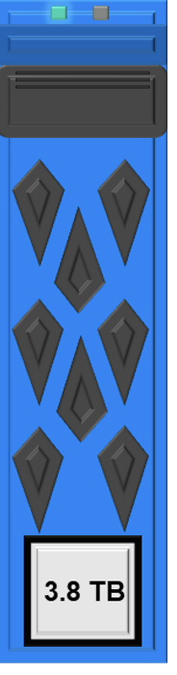







Над чем работаем
Просто диски
101010101
010101101
Флеш
Программно
-определяемые
Защита
данных
Облака
Виртуализация
другое
Упрощение
AI, ML
аналитика
Контейнеры
Безопасность
Модель
потребления
© 2019 NetApp, Inc. All rights reserved. --- NETAPP CONFIDENTIAL ---
Notes:
Note that the capacity gains on SDF are largest for smallest configuration systems. This is because the benefits of:
Extra raw capacity (less over-provisioning with SDF)
Extra usable & effective capacity (one fewer parity drive with SDF)
Are most prominent with SDF.

Slide 11

Философия NetApp
Инновации ради заказчиков
Внедряем прорывные технологии «инвазивно» без полной замены платформ
…часто без остановки сервиса …
  В тот момент, когда это уже не хайп и очевидны преимущества для. Когда новые носители уже проверены, надежны и обеспечивают лучшие показатели TCO

Slide 12
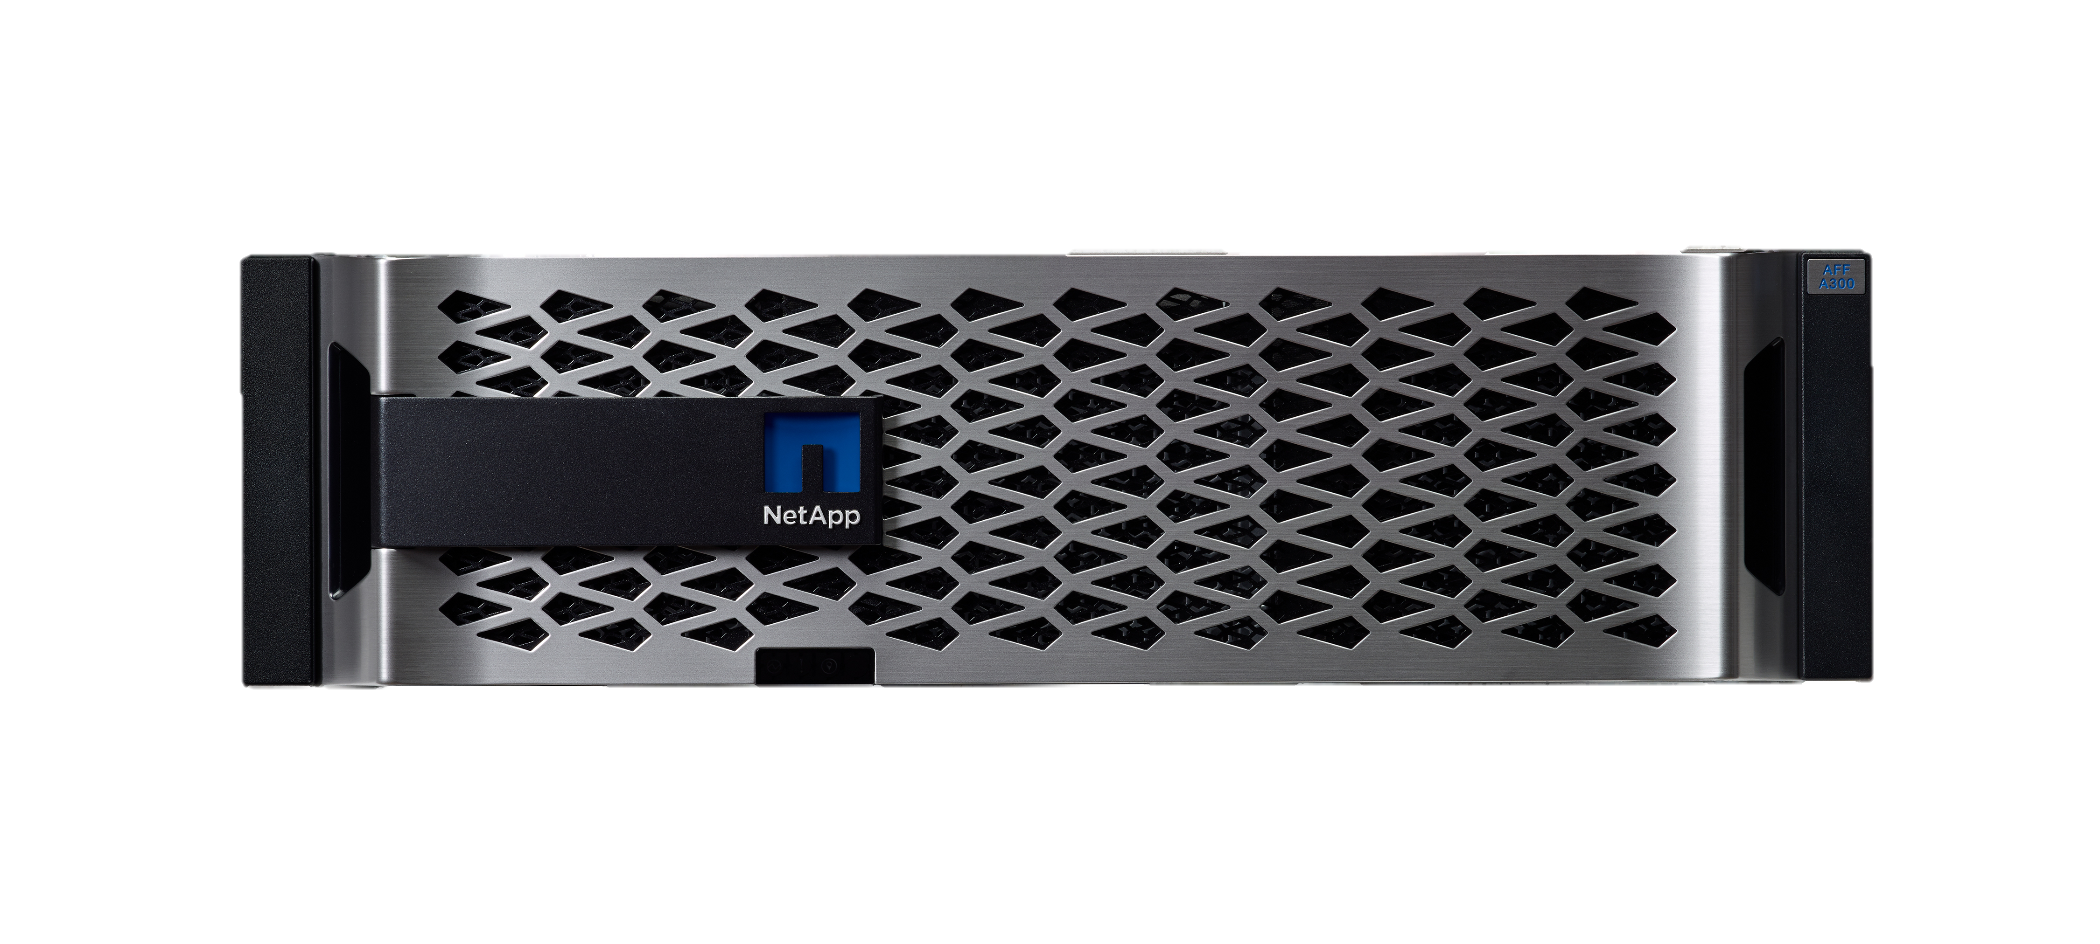
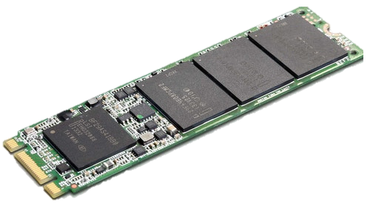

NVMe
NetApp представившим первое решение end-to-end enterprise NVMe
Обновление до утрасовременного SAN без перерыва в работе
Улучшение производительности на 60%
Снижение задержек на 50%
Notes:
Nondisruptive upgrade to a modern SAN
Deliver 60% more performance
Reduce latency by 50%
Simple ONTAP upgrade to existing systems
2020: Completing rollout
A250 launch completes end-to-end NVMe SSDs to NVMe/FC across high/mid/entry AFF portfolio.
2021+ Vision
ONTAP is already NVMe/Ethernet “ready”
Preparing for introduction of NVMe/TCP, reviewing NVMe/RoCE v2

Slide 13
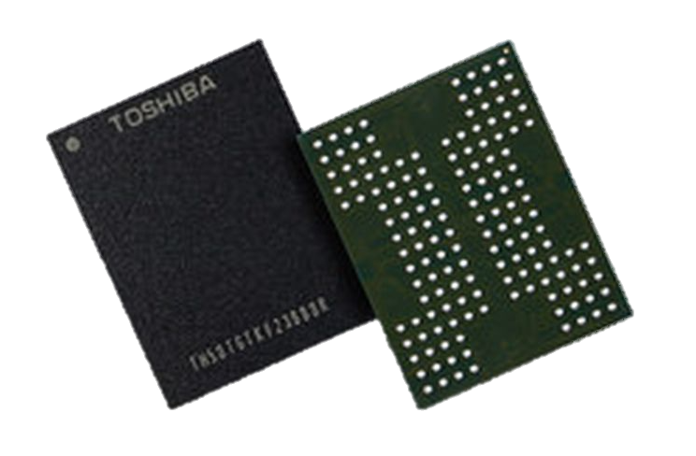
QLC
NetApp движется в сторону QLC…
FAS500f доступны с 2020 года
Мы верим в постепенную миграцию от дисковых систем к Flash системам, построенным на QLC носителях
Все возможности ONTAP, включая NVMe/SAN/NAS/S3 и масштабирование scale-out
Можно объединять без останова в одну систему AFF/FAS с носителями разного типа - TLC, QLC, 10K и 7.2K
4-bit-per-cell
Технология QLC- quadruple-level cell

Slide 14

Ключевые факты
  Самый быстрорастущий SAN производитель
  Рост QoQ для AFF SAN составляет 42%
  62% заказчиков AFF используют SAN
  60% новых заказчиков NetApp используют SAN
  Поставлено более 6.2PB NVMe носителей
Технологическое лидерство
  Первая СХД с 1GbE iSCSI
  Первая Unified (SAN + NAS) СХД
  Первая FCoE СХД
  Первый Unified Target (один порт для FCoE + IP)
  Первая СХД с 10GbE iSCSI
  Первая СХД с primary SAN deduplication
  Первый на рунке 15.3TB SSD
  Первое решение с 32 Gig FC end-to-end
  Первая СХД с 10GbE 100GbE/40GbE
  Первый производитель с 12 узловым SAN
  Перовое решение NVMe End to End NVMe/FC

Slide 15

29 лет инноваций
Data ONTAP 8
Data Motion
FlexPod
Bycast/StorageGRID Acquisition
SSD Aggregates
FAS2500
FAS8000
All Flash FAS (AFF)
StorageGRID WebScale
SteelStore/AltaVault Acquisition
Data ONTAP 9
AFF700/300
FAS9000/8200/2600
NVMe
Inline Data Compaction
15TB SSD
RAID-TEC
NetApp FlexGroup
Volume Encryption
SolidFire Acquisition
Scale Out
Data ONTAP® GX
SnapManager for Oracle
FlexShare & MultiStore
Kilo Client Lab in RTP
(Genesis of FlexPod)
Network Based
Backup Protocol
Multiprotocol NAS Appliance
NFSv2
Unified NAS/SAN
SnapVault
SnapLock
NearStore
Native Infiniband
Direct Access File System (DAFS)
Performance Acceleration Module SnapManager for VMware, Hyper-V, SharePoint, SAP
Onaro/OnCommand Insight Acquisition
Clustered Data ONTAP
Flash Pool
Flash Accel
ONTAP Edge
Dynamic Disk Pools
Data ONTAP 7G
FlexVol
FlexClone
Thin Provisioning
NVMe /FC
32TB SSD
MAXData
All Flash FAS A220
NDAS
100Gb Ethernet
Flash Cache II
FAS Compression
Flash Pool
Engenio/E-Series Acquisition
Akorri/OCI & OPM Acquisition
Data Fabric
AFF Fast Path enhancements,
In-line zero block dedupe, adaptive compression, deduplication
1st NAS
Appliance
Snapshots
Database Solutions
HA NAS
Flash Cache I
FCoE
Protection Manager
File Level FlexClone
FabricPool Cloud Tiering
Expanded Inline Dedupe
32Gb FC
40Gb Ethernet
Write
Anywhere
File
Layout
MetroCluster
SnapManager for SQL
NFSv4
Deduplication for Tier 1 & 2
Rapid RAID Recovery
iSCSI
V-Series
RAID-DP®
EF540 Flash Array
UTA
Sync SnapMirror
Fast Failover
SnapManager Exchange
SnapRestore
SnapMirror
History of NetApp
1993
1997
2000
2003
2005
2007
2009
2011
2013
2015
2017
2019
1992
1996
1999
2002
2004
2006
2008
2010
2012
2014
2016
2018

Slide 16
Спасибо

Slide 17
Leadership across the portfolio
ESTABLISHED
LEADERSHIP
    A Leader in Gartner Magic Quadrant for Primary Storage Arrays
    #1 Storage & Device Management Software
    A Leader in Object Storage
    A Leader in File-Based Storage
ACCELERATING
MOMENTUM
Fastest Growing Software-Defined Storage Controller Software vendor
Fastest Growing Archiving Software vendor
UNIQUELY
POSITIONED
  The biggest clouds are choosing NetApp
Gartner, Magic Quadrant for Primary Storage Arrays, 30 November 2020, Santhosh Rao, Roger W. Cox, Joseph Unsworth, Jeff Vogel
IDC, Worldwide Storage Software and Cloud Services Qview – 2020Q3, December 8, 2020 #1 Storage & Device Management Software vendor – revenue share; Fastest Growing Software-Defined Storage Controller Software vendor – 2019Q3-2020Q3 YoY revenue growth; Fastest Growing Archiving Software vendor – 2019Q3-2020Q3 YoY revenue growth
IDC, MarketScape: Worldwide Object-based Storage, December 2019
IDC, MarketScape: Worldwide Scale-Out File-Based Storage, December 2019
Notes:
Gartner Magic Quadrant for Primary Storage Arrays, November 30, 2020
IDC, Worldwide Storage Software and Cloud Services Qview - 2020Q3, December 8, 2020
#1 Storage & Device Management Software vendor – revenue share
Fastest Growing Software-Defined Storage Controller Software vendor – 2019Q3-2020Q3 YoY revenue growth
Fastest Growing Archiving Software vendor – 2019Q3-2020Q3 YoY revenue growth
IDC, MarketScape: Worldwide Object-based Storage, December 2019
IDC, MarketScape: Worldwide Scale-Out File-Based Storage, December 2019

