Slide 1

Skolkovo, Russia
October 15, 2021
Dr. James Muller
CMO, SpectraWAVE, Inc.
Cardiologist, Brigham and Women’s Hospital
Harvard Medical School
Успех в обнаружении уязвимых бляшек и уязвимых пациентов:
Значение для клинической помощи и исследований

Slide 2
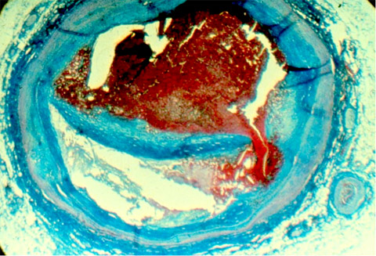
Coronary Heart Disease
World’s Leading Cause of Death⁽¹⁾
Stenting complications
continue to occur
Patients experience events
from new lesions ⁽²⁾
www.who.int/mediacentre/factsheets/fs310/en/
Prospect Study, NEJM, Stone et al.
Thin Cap
Rupture
Autopsy Specimen of Coronary Plaque Causing a Fatal Heart Attack

Slide 3
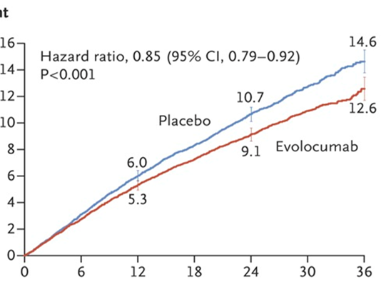
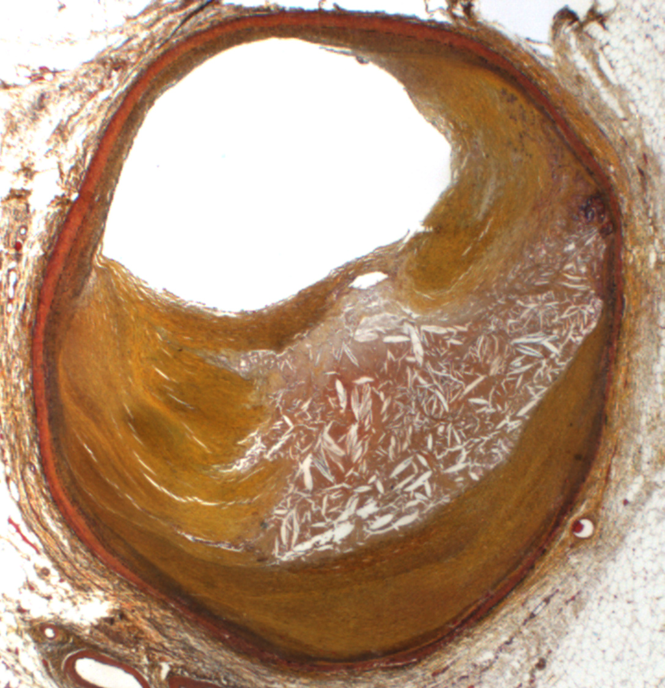
What Causes Events With an LDL of 30 mg/dL?
Sabatine et al, NEJM, 2017; 376:1713-1722

Slide 4
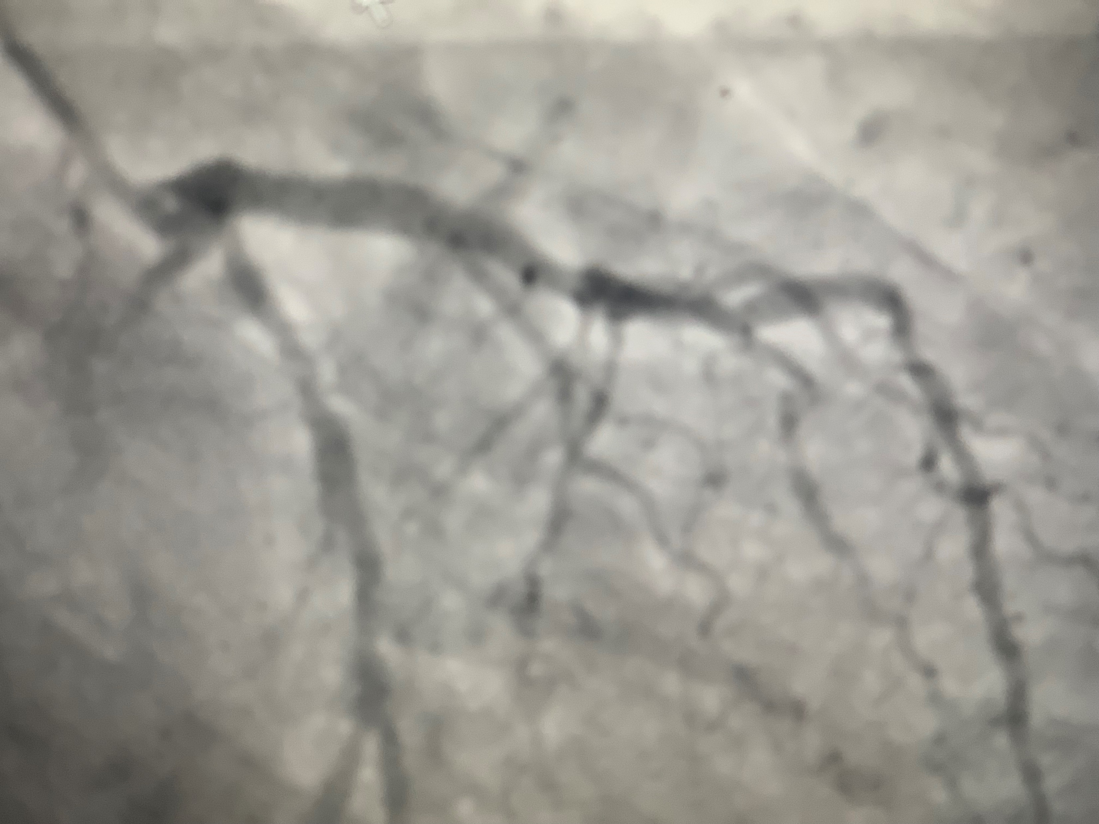
Будет ли бляшка, которую они не стентировали,
вызвать новый сердечный приступ?

Slide 5
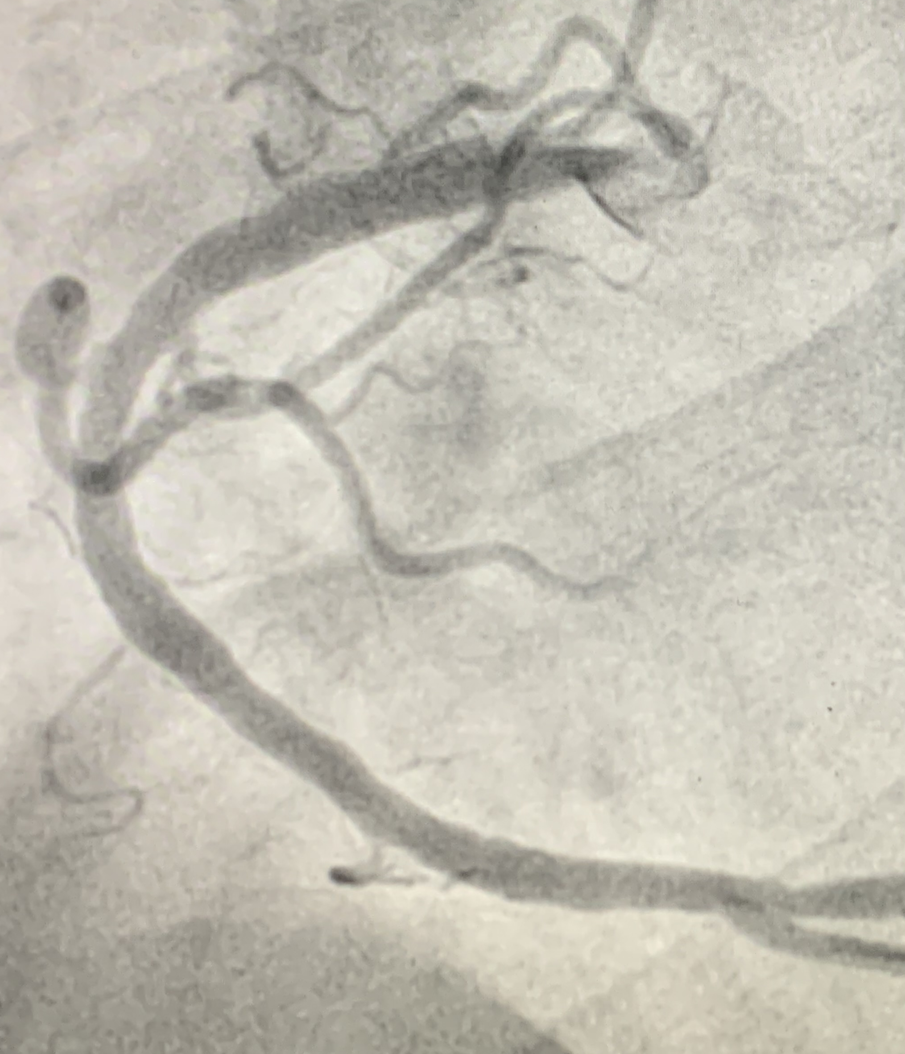
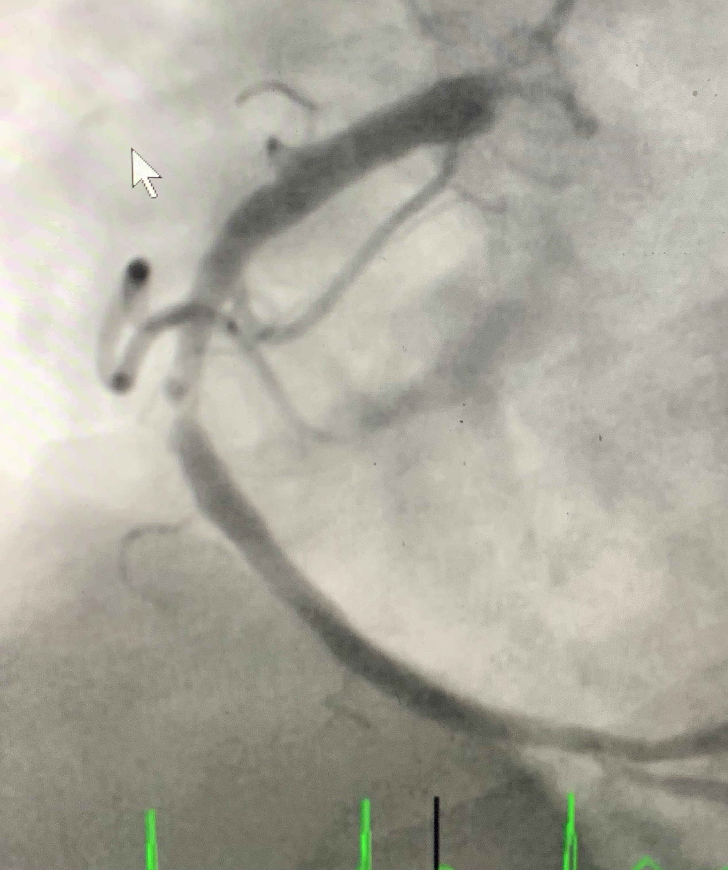
Профилактика новых коронарных событий
2014
2019
64 yo male
HLD, HBP, DM
80 Atorvastatin
81 mg aspirin
LDL 40 mg/dL
60 lb wt loss
STEMI

Slide 6

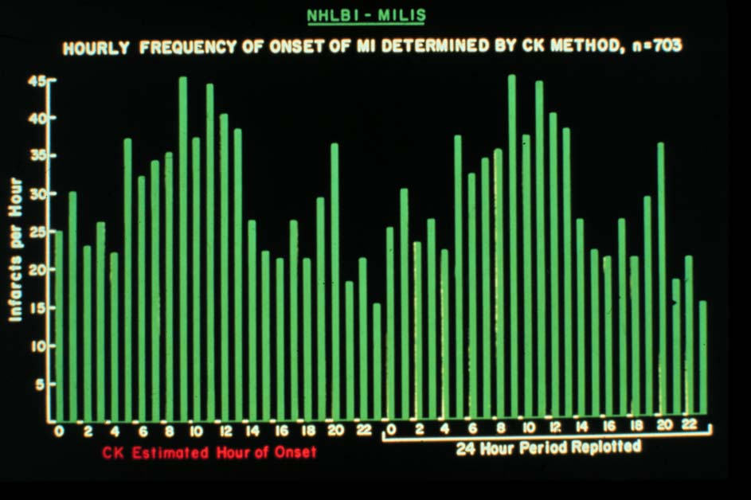
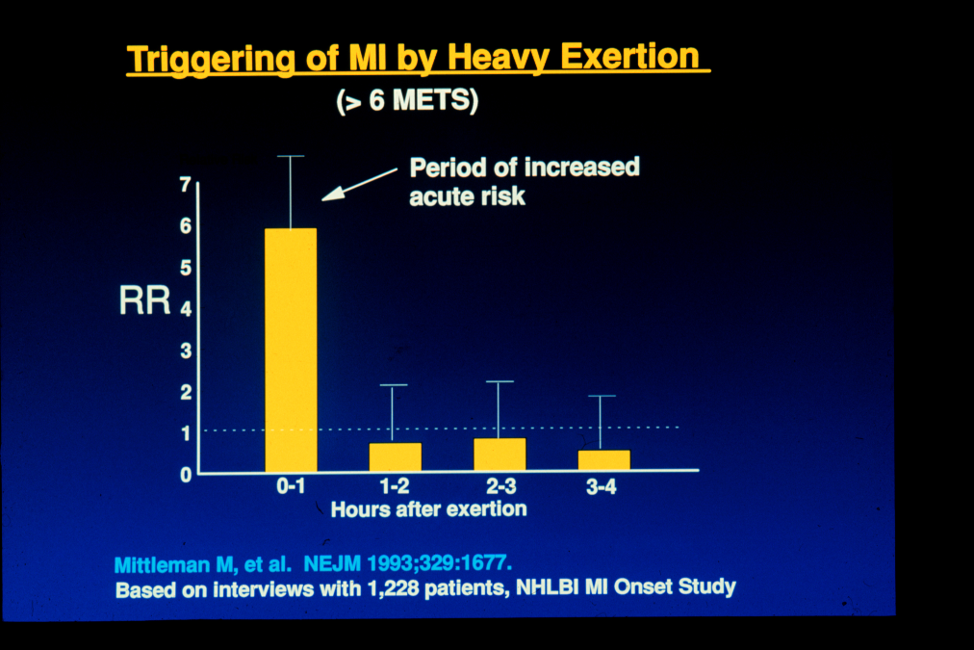
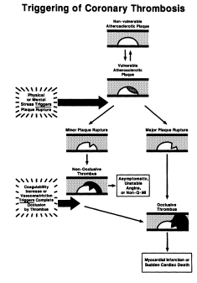
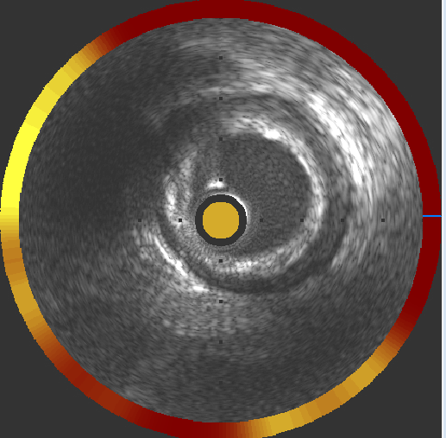
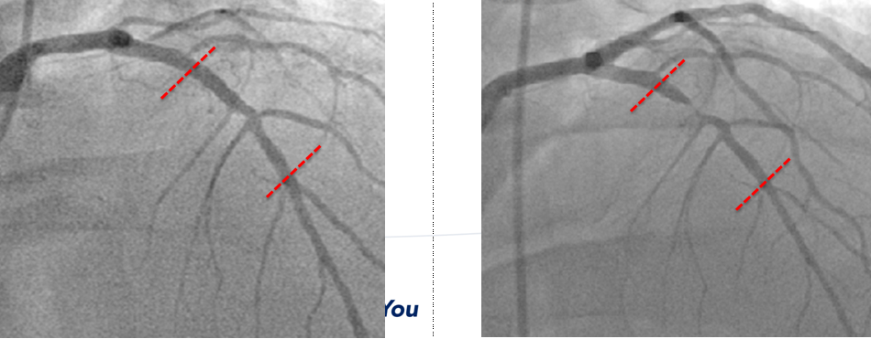
Vulnerable
Plaque
Detection
by NIRS
Circadian Variation of MI
Vulnerable
Plaque
Concept
Triggering of MI
Muller et al, NEJM 1985 Mittleman et al, NEJM 1993 Muller, Stone, Tofler, Circulation 1989 Waksman et al, TCT, 2018

Slide 7
Vulnerable Plaque Concept Introduced
1989, J.Muller, G. Tofler, P. Stone.

Slide 8
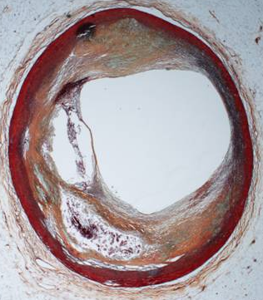
ответ

Slide 9
Ex Vivo NIRS Can Easily Discriminate Cholesterol From Collagen
1.0
0.8
Cholesteryl
Cholesteryl
Oleate
absorbance
Oleate
Cholesterol
0.6
Cholesterol
Collagen
Collagen
0.4
Steve DeJesus
Dr. Robert Lodder,
Spectroscopist,
University of Kentucky, 1998
Cholesteryl
Cholesteryl
Linoleate
Linoleate
0.2
1100
1200
1300
1400
1500
1600
1700
1800
1900
wavelength

Slide 10
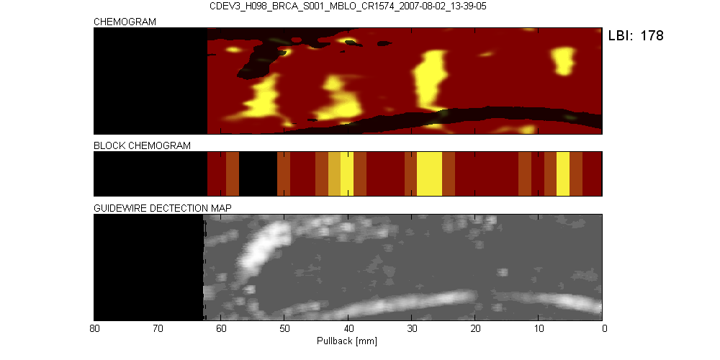
Comparison of Chemogram with Coronary Autopsy Histology
40 mm
36 mm
26 mm
20 mm

Slide 11

Zachin,
Christie
and
Raber
Coronary
Intervention
2021

Slide 12
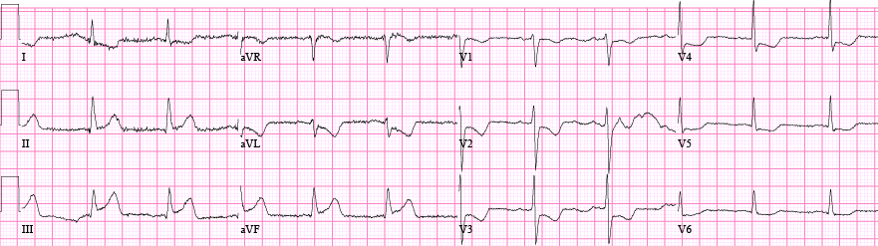
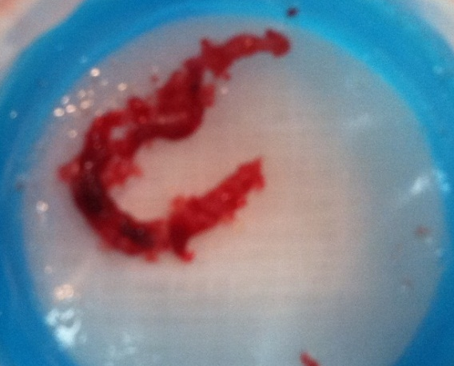
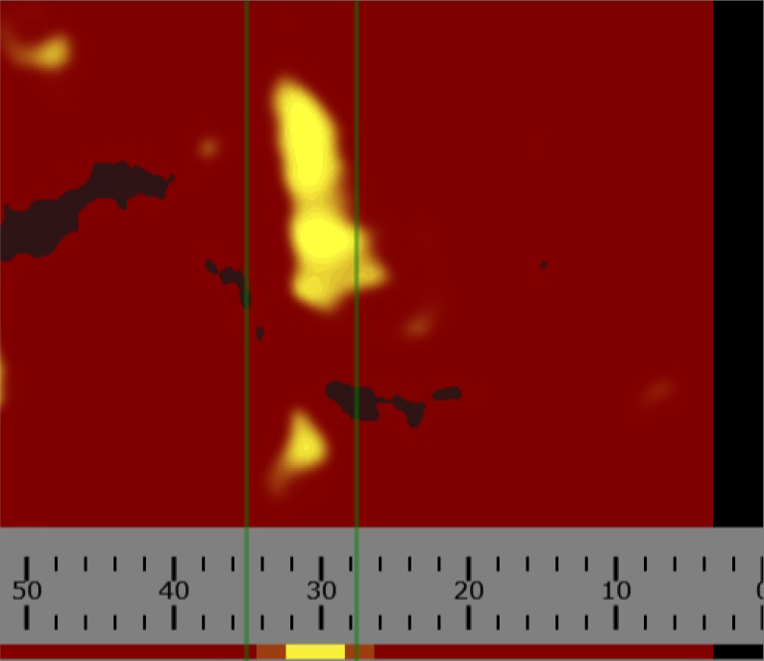
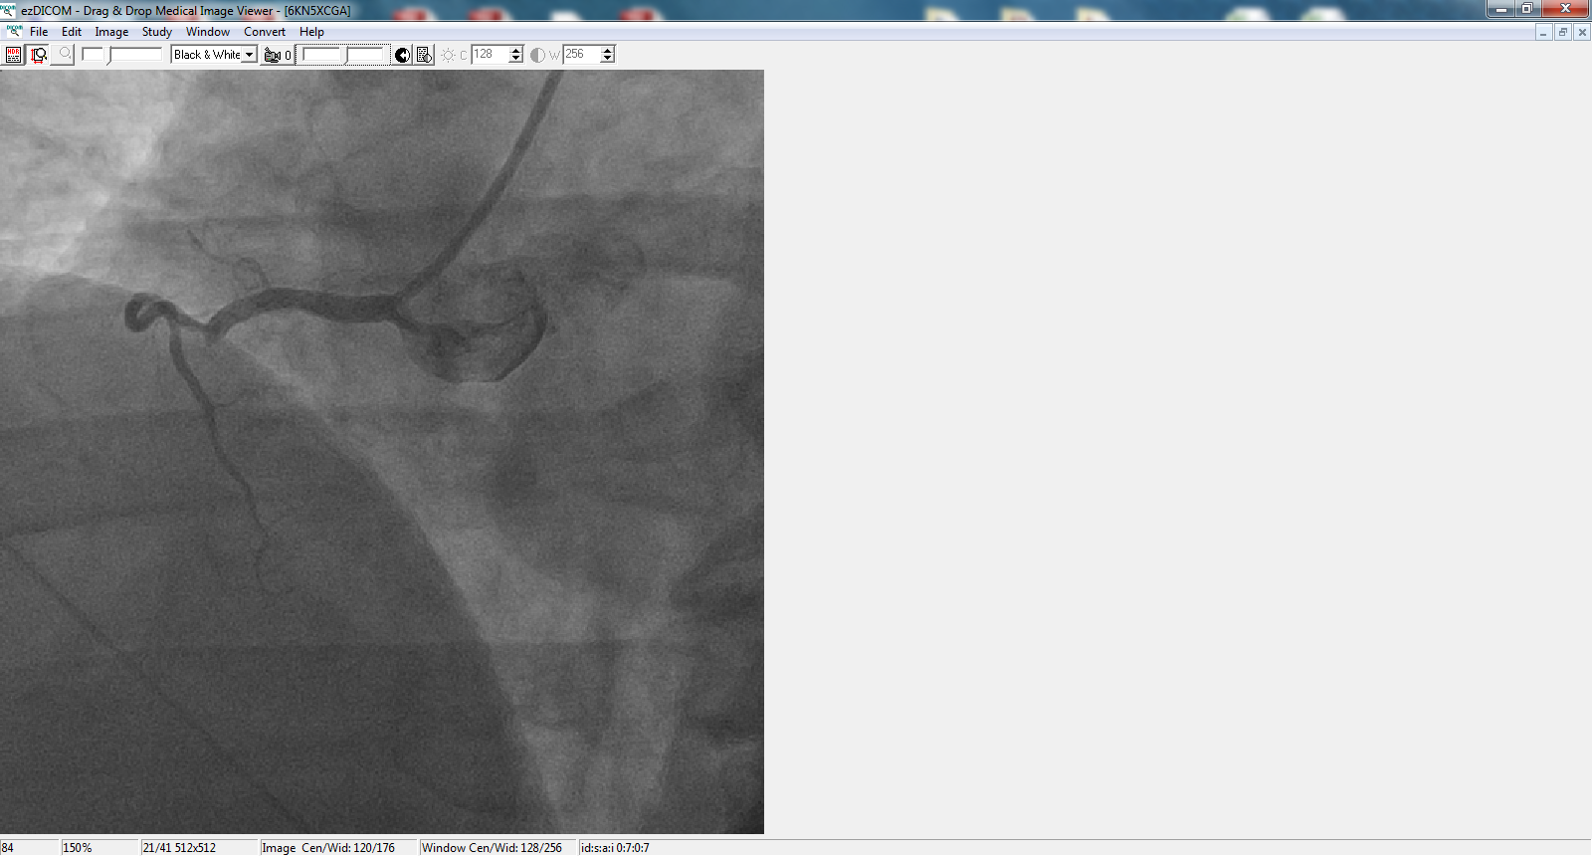
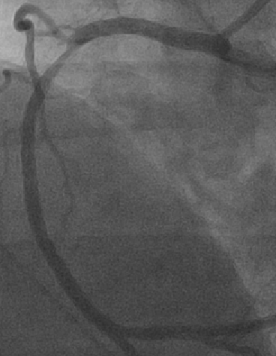
Courtesy Dr. Ryan Madder, TCT 2012

Slide 13
The Vulnerable Plaque Hype-pothesis
Steve Nissen, MD, CRT Meeting, 2010
Requiem for the ‘vulnerable plaque’
Peter Libby and Gerard Pasterkamp, EHJ, March 2015
Реквием по уязвимой plaque
The Myth of the “Vulnerable Plaque”
Transitioning From a Focus on Individual Lesions to
Atherosclerotic Disease Burden for Coronary Artery Disease Risk Assessment
Armin Arbab-Zadeh, MD, PHD,* Valentin Fuster, MD, PHD: JACC 2015

Slide 14
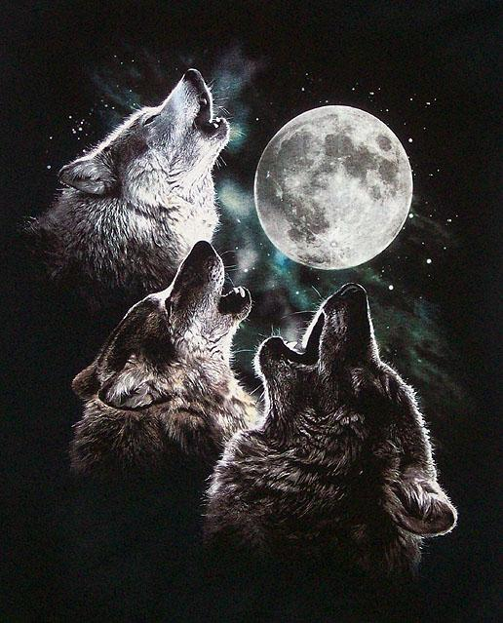
Soon, the Data will Speak
время покажет,
первый канал
Notes:
14
Ruptured plaques and TCFA, the structures suspected to be the most dangerous, occupied < 3% of the length of the arteried -- a focal process.

Slide 15
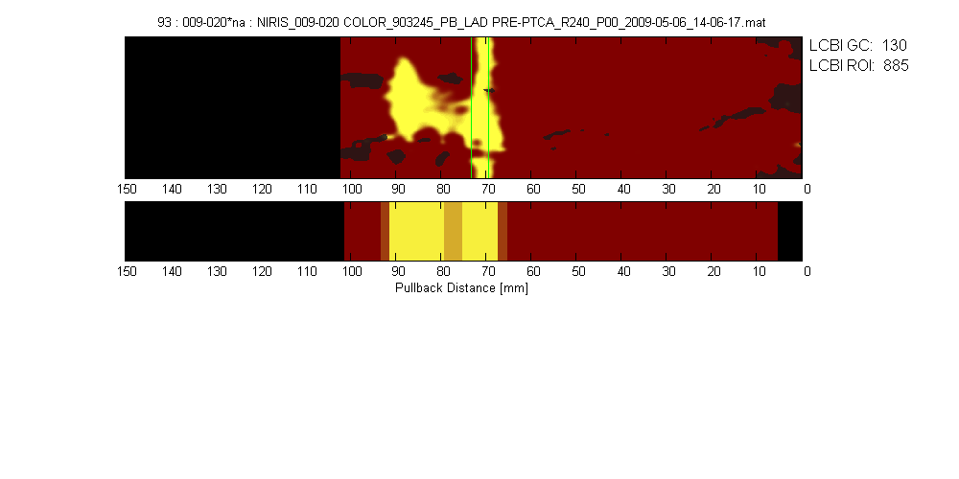

The Lipid-rich Plaque (LRP) Study Dr. Ron Waksman, PI; PI, Europe, Dr. Carlo Di Mario
Results Presented
TCT Sept, 2018
2 year MACE from a new lesion at patient and coronary segment level
1563 PCI
patients
with ACS or SA
with NIRS-IVUS
imaging of
2 or more
vessels

Slide 16
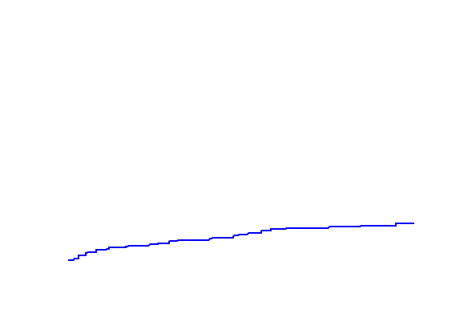
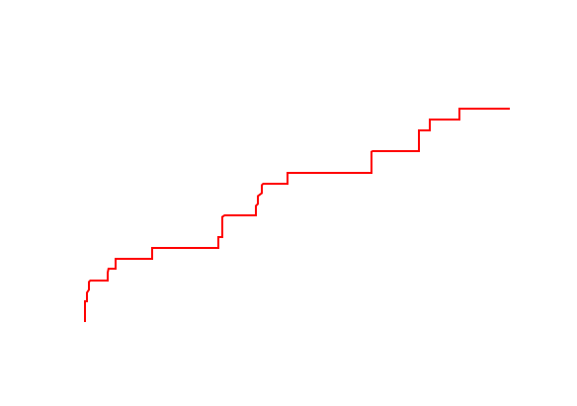
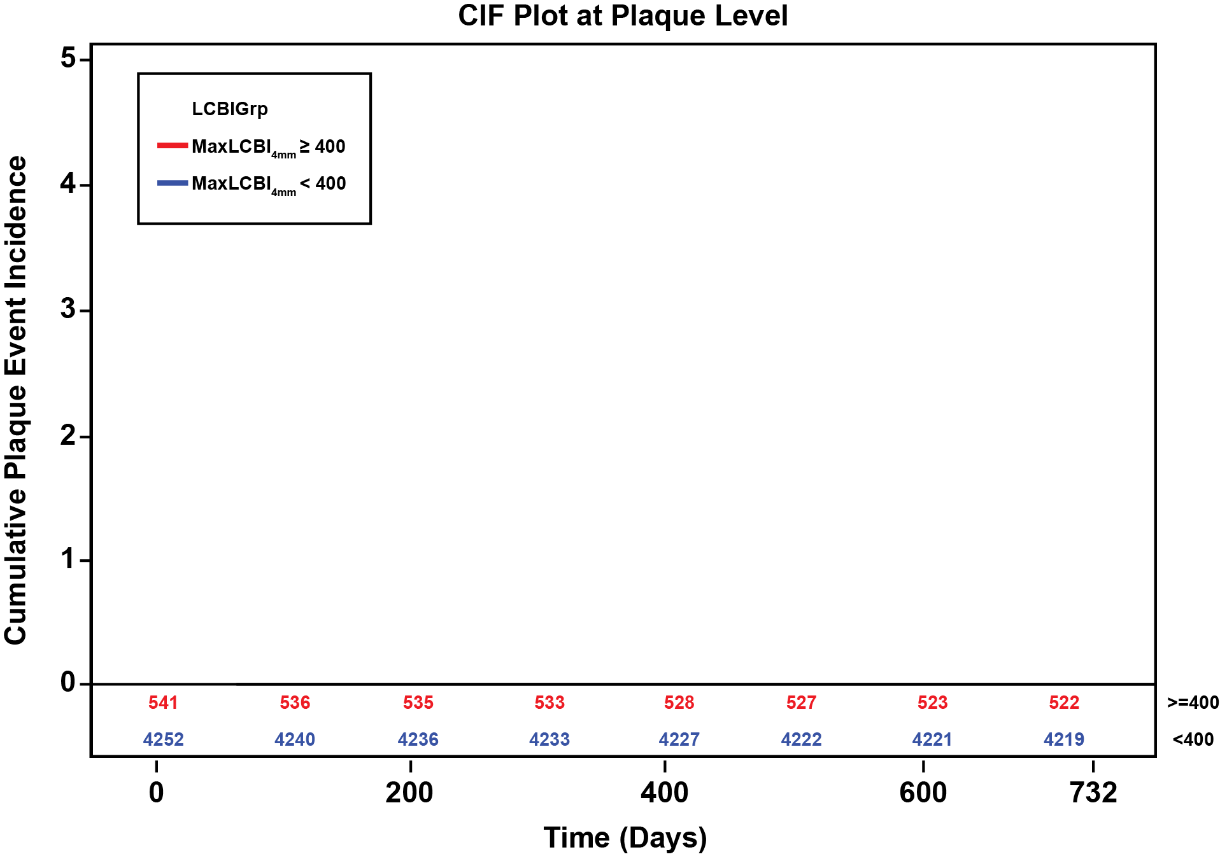
Plaque NC-MACE Incidence in LRP
p_{logrank}<0.001
3.7%
Cumulative NC-MACE Incidence
0.8%

Slide 17
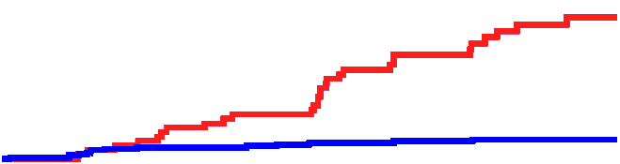
PROSPECT II Trial, NIRS Predicts MACE, Erlinge et al, Lancet, 2020
MaxLCBI_{4mm}>324.7
MaxLCBI_{4mm}<324.7
898 Scandinavian patients with recent MI
NIRS predictive of NC-MACE with OR 7.5
OR 7.47 95% CI 3.93-14.20
NC-MACE (%)
Number at risk:
Years
≥324.7
851
837
830
621
359
<324.7
2,649
2,623
2,610
1,976
1,092

Slide 18
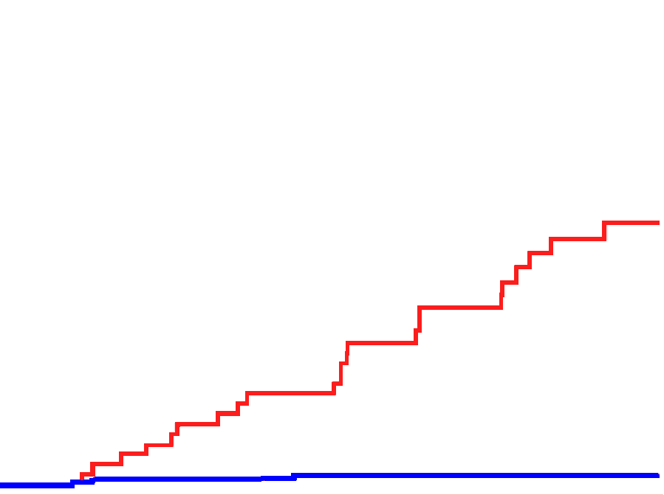
PROSPECT II Trial, NIRS + Plaque Burden Predicts MACE Erlinge et al, Lancet 2020
MaxLCBI_{4mm}>324.7, PB>70%
MaxLCBI_{4mm}<324.7, PB<70%
OR 36.73 95% CI 13.59-99.28
898 Scandinavian patients with recent MI
NIRS + PB predictive of NC-MACE with OR 36.7
NC-MACE (%)
Number at risk:
Years
PB ≥70% maxLCBI_{4mm} ≥324.7
374
368
362
271
162
PB <70% maxLCBI_{4mm} <324.7
2,258
2,240
2,229
1,683
924

Slide 19
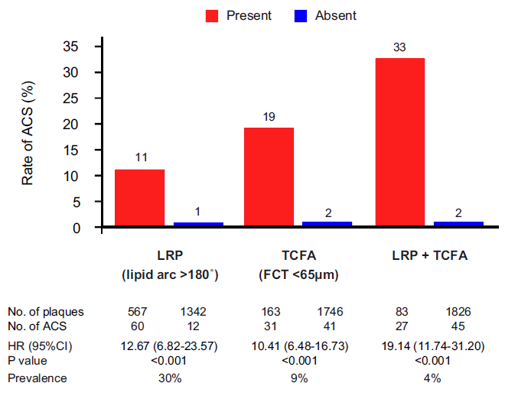
TCFA by OCT Predicts Future ACS
Kubo et al, EHJ CI, 2021
Present Absent
1378 patients with low to intermediate stenosis
6 Yr median follow up
72 ACS in OCT-imaged vessels
Non-lipidic 100% NPV
HR>10 for OCT LRP, TCFA, combination.”

Slide 20
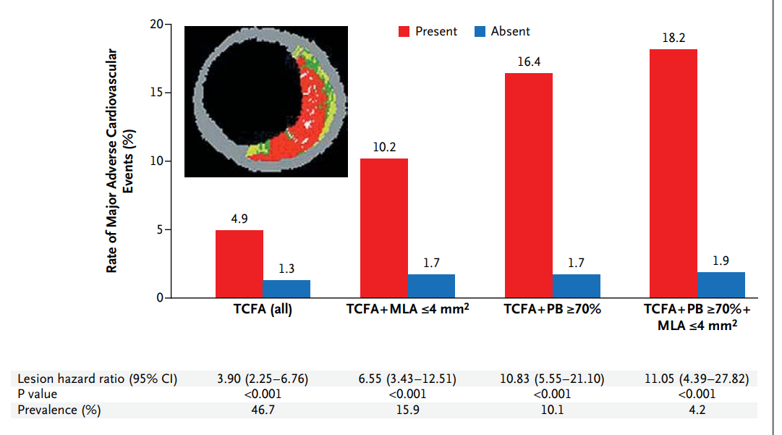
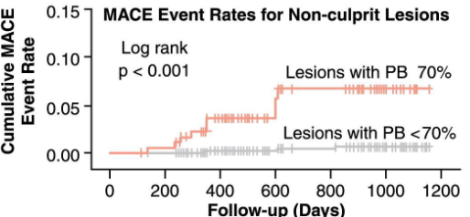
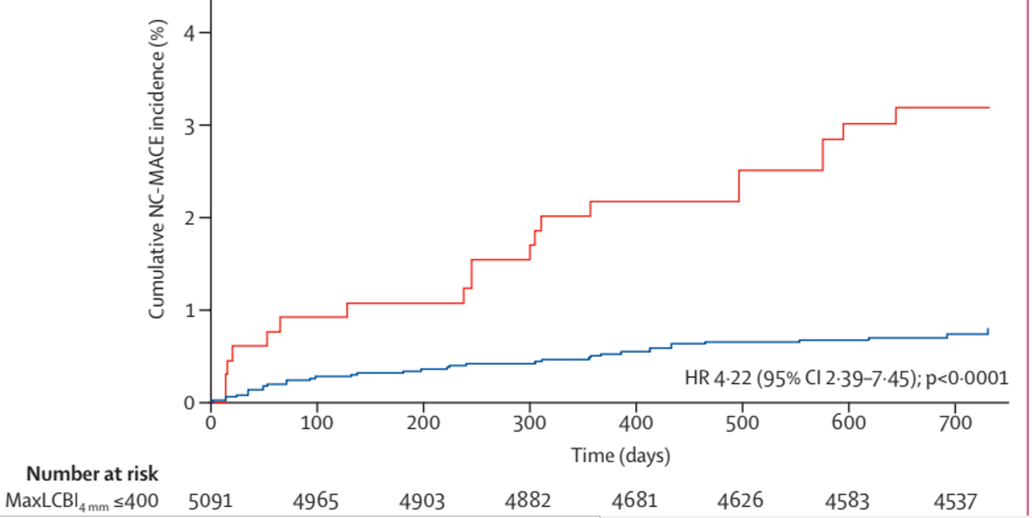
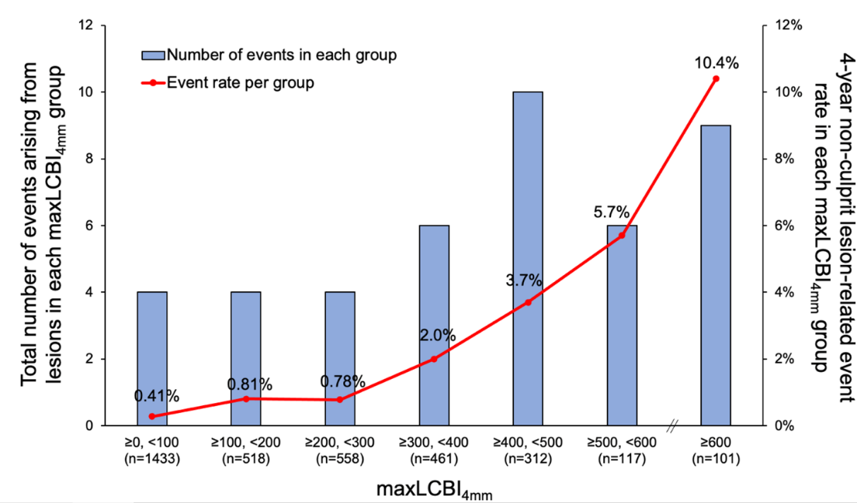
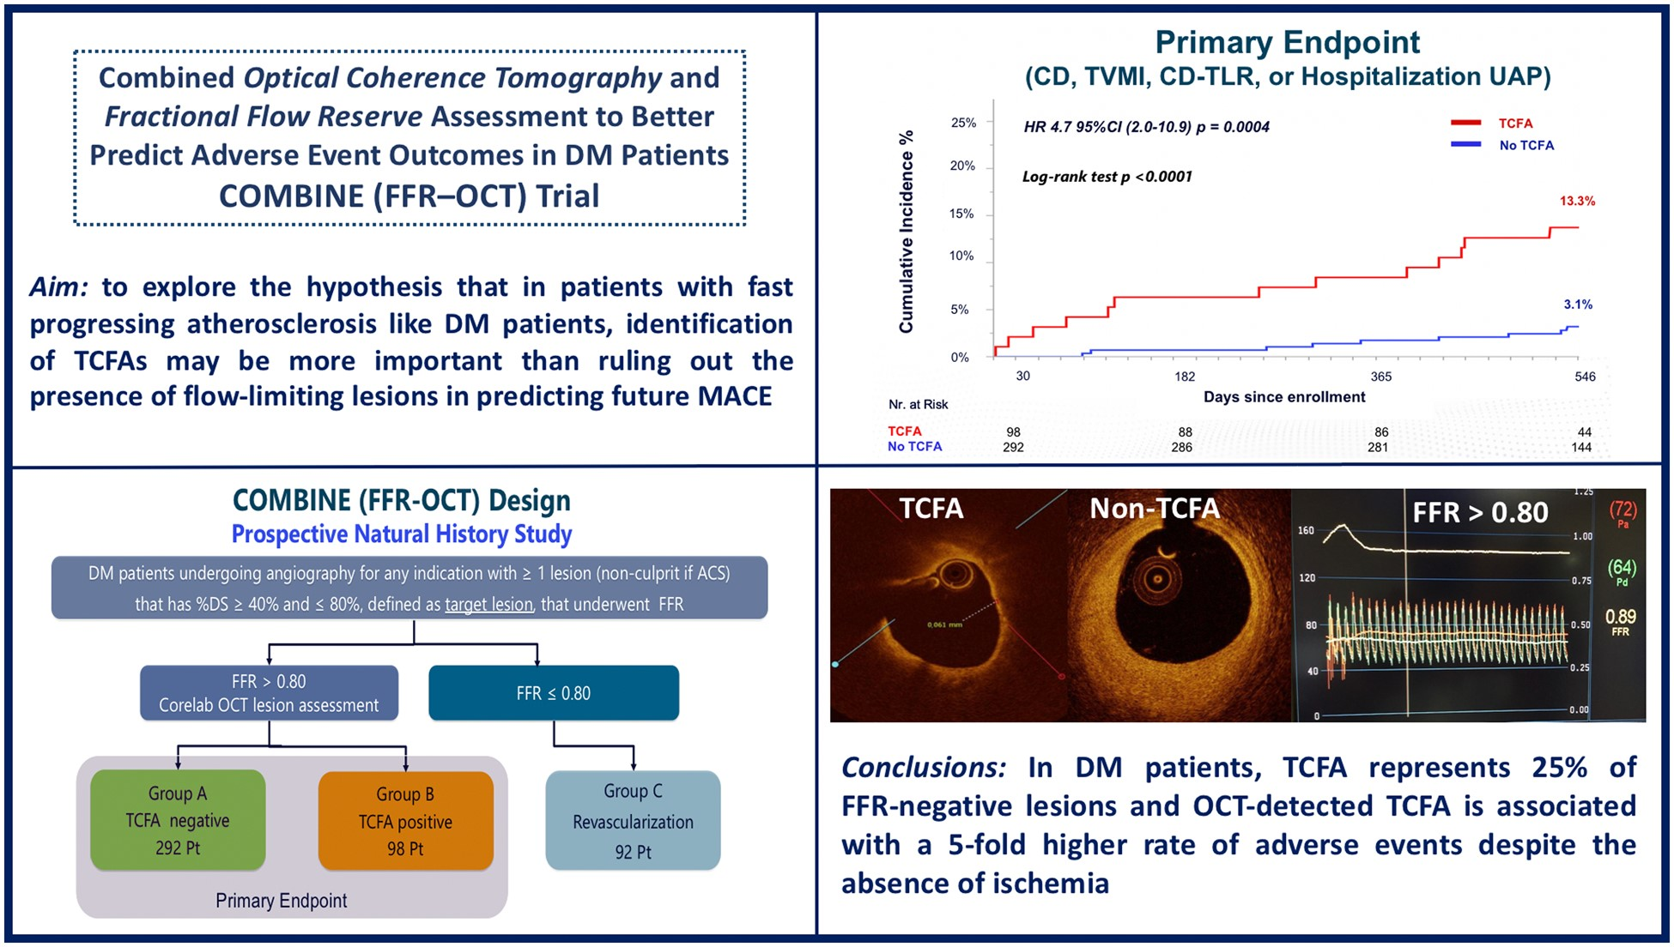
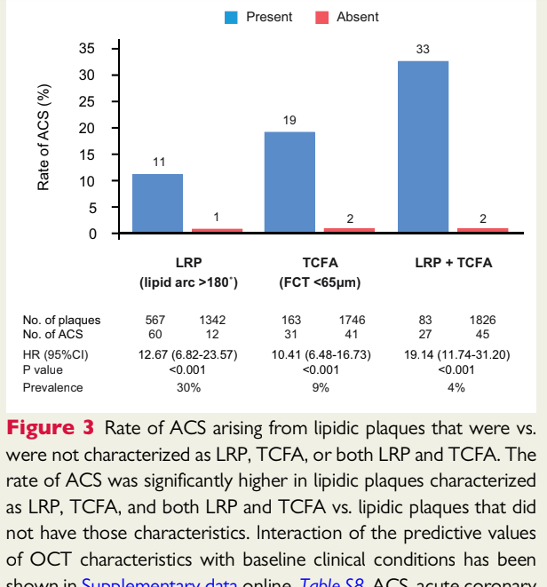
Six Positive Vulnerable Plaque Detection Studies
PROSPECT ONE, Stone et al, NEJM, 2011 VIVA, Calvert et al, JACC CV Imaging 2011 LRP, Waksman et al, Lancet 2019
PROSPECT Two, Erlinge et al, Lancet 2021. COMBINE OCT-FFR, Kedhi et al, Eur H.J. 2021. Kubo et al, Eur H. J. CV Imaging, 2021.

Slide 22
Tip of prototype catheter
created by Tearney lab
Fard AM et al. Opt Express. 2013
In 2017, Drs. Tearney, Stone and Muller founded SpectraWAVE, Inc.

Slide 23
Single and Multimodality Catheter Systems
OCT
OCT-NIRS
Resolution
Lipid
IVUS
IVUS-NIRS
Plaque Composition

Slide 24
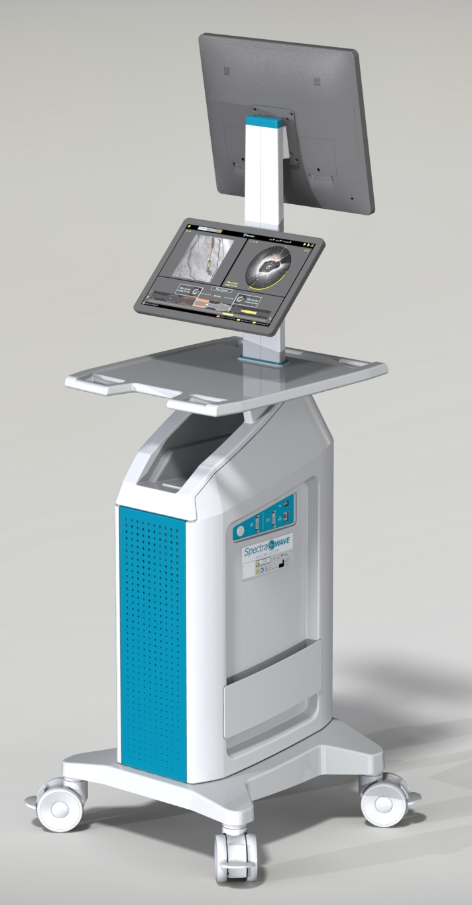
SpectraWAVE System OCT-NIRS System

Slide 25
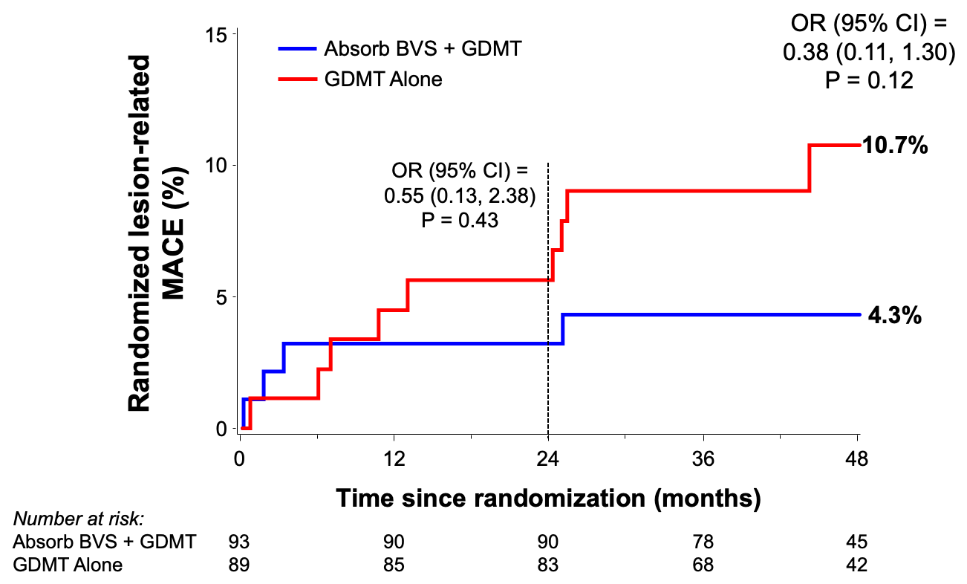
The PROSPECT–ABSORB Study of Local Treatment of Vulnerable Plaque
182 Scandinavian patients withnon-stenotic, non-culprit lesions(>65% PB) randomized to BVS or GDMT
BVS treatment of vulnerable plaques tended to reduce adverse outcomes (OR 0.38)
PROSPECT ABSORB Stone et al., JACC 2020

Slide 26
Предупреждение о стентировании нестенотических «уязвимых» бляшек
Кардиолог из Огайо приговорен к 20 годам тюремного заключения за завышение счетов Medicare на 5,7 миллиона долларов за ненужные процедуры
Dr. X received his medical education in London, England.

Slide 27
Рандомизированные исследования стентирования уязвимых бляшек
Local therapy for prevention of coronary events is being tested in the PREVENT Trial being led by Dr. S.J. Park and Dr. Gregg Stone.
Vulnerable plaques are identified by IVUS, OCT or NIRS-IVUS.
Approximately 1500 patients have been randomized to stenting or no stenting.
Results expected in late 2022
Dr. Prati will conduct a randomized trial of OCT-guided treatment of intermediate stenoses.
Dr. Kedhi will conduct an OCT study of stenting of vulnerable plaques
funded by Abbott.
Cryotherapy and DCB might also be useful local treatments.

Slide 28
Будущее
Используйте визуализацию OCT-NIRS для выявления бляшек с более высоким риском, чем стенты, баллоны с лекарственным покрытием, или криотерапия

Slide 29
Модифицированный алгоритм Браунвальда для скрининга
и лечения уязвимых бляшек с целью первичной профилактики
Framingham Risk Score
Low: <0.5%
Lifestyle Change, Follow-Up
Inter: 0.5-2%
RX Risk Factors, Additional Tests
High: >2%
Intense Global Risk Reduction
Genetic and Proteomic Screen
High: >2%
Noninvasive for VP
Very High: >15%
?STENT, DCB or Cryo
Invasive for VP
NIRS IVUS,
NIRS OCT
Very High: 25%
Local Rx
Courtesy of Dr. Gregg Stone
Braunwald E. JACC 2006;47;C101-C103

